Slide 1
Fingerprint Voting System
Mohamed Ehab Hassan Sayed
Group 2
Section 3
Presentation

Slide 2
Projects Charter
Project name: Fingerprint Voting System
Project sponsor: National Election Authority
Project manager: Mohamed Ehab Hassan
Purpose: More accurate & easier voting system
Business case: Solving many problems in the current traditional voting System in Egypt by using a fingerprint-based voting system, since a fingerprint is unique for every one, then using it in the voting process will make sure that the votes are true and will give us the accurate results.
Project scope: The system will:
register the citizens using the personal ID information and up to 3 Fingerprints per citizen.
the system will count the votes.
publish the results, then store the results in the DBMS.
Key deliverables of the project: the system will:-
(1) Identify users using fingerprints. (2) make sure that each voter can vote only once.
(3) Calculate the votes (3) store the results in the DBMS temporary.

Slide 3
Project resources:
(1) A computer engineers team (2) A team of telecommunication engineers.
(3)A team of Programmers. (4)A team of security administrators.
(5)Fingerprint scanner devices. (6)Database storage system.
(7)Network devices.
Budget:
7,000,000 $ (fingerprint devices, IS storage systems, Network, servers, engineers, developers, Training)
Constraints:
(1)The project must take less than 1 year. (2)The cost no more than 7,000,000 $.
(3)The DBMS must be bought from Oracle.
Assumptions:
(1)The project doesn’t take more than 1 year. (2)cost is not more than 7,000,000 $.
(3)Efficient fingerprint devices. (4)The database has enough storage.

Slide 4
Project scope statement
Project Scope Description:
1.The system will allow the voters to use their fingerprints to vote.
2.The system will automatically count the votes and determine the winner candidate.
3.The system will save the results in a secure database.
Project Acceptance Criteria:
(1)Simple user interface. (2)Fast votes counting. (3)Strong security system.
Project Deliverables:
(1)Project plan, reports, documents. (2)Easier, faster and more accurate election process.
Project Exclusions:
(1)One of the voters wants to store more than 3 fingerprints but the manager refuses.
(2)A researcher wants the system to store the results for a longer time than determined.
Project Constrains:
(1)The rules of the election process according to the Egyptian constitution.
(2)Budget. (3)The launching date.
Project Assumptions:
(1)Storage for the database not less than 5 zettabytes.
(2)Available Fingerprint-Scanner devices not less than 1 million devices.

Slide 5
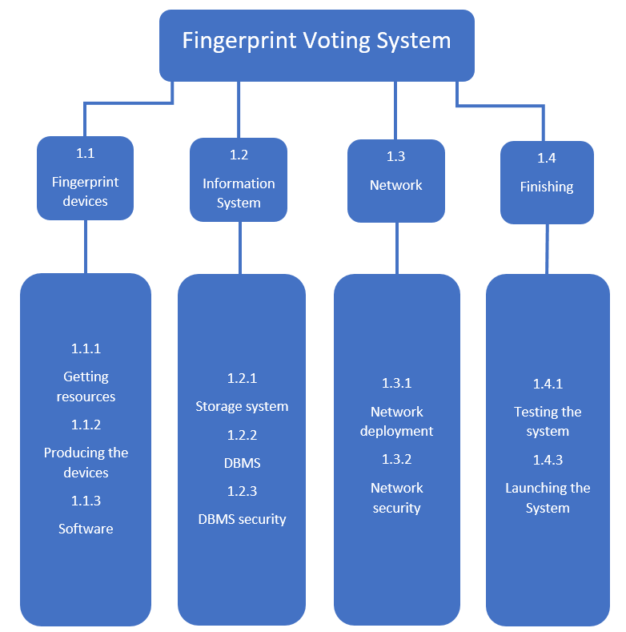
WBS

Slide 6
WBS Dictionary
Work package ID | 1.1.1
Work package Name | Getting resources
Description | making the required resources
Person(s) | The computer engineers team leader
Start Date | 1/ 1 / 2022
End Date | 31/ 1 / 2022
Work package ID | 1.1.2
Work package Name | Producing the devices
Description | Manufacturing the fingerprint-scanning devices
Person(s) | The computer engineers team leader
Start Date | 1/ 2 / 2022
End Date | 1/ 4 / 2022
Work package ID | 1.1.3
Work package Name | Software
Description | Developing the software to run the devices
Person(s) | The developers team leader
Start Date | 1 / 4 / 2022
End Date | 1/ 6 / 2022
Work package ID | 1.2.1
Work package Name | Storage system
Description | Establishing a reliable storage system
Person(s) | The computer engineers team leader
Start Date | 1 / 1 / 2022
End Date | 1 / 3 / 2022

Slide 7
Work package ID | 1.2.2
Work package Name | DBMS
Description | Developing a reliable DBMS
Person(s) | The developers team leader
Start Date | 1 / 3 / 2022
End Date | 15 / 4 / 2022
Work package ID | 1.2.3
Work package Name | DBMS security
Description | Making a strong security system to the DBMS
Person(s) | Security admins & The developers team leaders
Start Date | 15 / 4 / 2022
End Date | 1 / 6 / 2022
Work package ID | 1.3.1
Work package Name | Network deployment
Description | Connecting the Fingerprint-scanner devices from all around Egypt to the DBMS using a reliable network
Person(s) | the network engineers team leader
Start Date | 15 / 4 / 2022
End Date | 1 / 7 / 2022
Work package ID | 1.3.2
Work package Name | Network security
Description | Making a strong security system to the Network
Person(s) | The security admins team leader & Network engineers team leader
Start Date | 1 / 7 / 2022
End Date | 15 / 8 / 2022

Slide 8
Work package ID | 1.4.1
Work package Name | Testing the system
Description | Doing some tests to the final system
Person(s) | Developers team leader
Start Date | 15 / 8 / 2022
End Date | 15 / 9 / 2022
Work package ID | 1.4.2
Work package Name | Launching the System
Description | Introducing the System to public
Person(s) | Manager
Start Date | 15 / 9 / 2022
End Date | 1 / 10 / 2022

Slide 9
RESPONSIBILITY MATRIX
 | Manager | Computer Engineers | Developers | Security Admins | Network Engineers
1.1.1 Getting resources | A | C
1.1.2 Manufacturing the devices | R | C | R
1.1.3 Software | A | P | C |  | R
1.2.1 Storage system | A | C | P
1.2.2 DBMS | R |  | C |  | P
1.2.3 DBMS security | A |  | P | C | P
1.3.1 Network deployment | A |  |  | R | C
1.3.2 Network security | A |  |  | C | P
1.4.1 Testing the system | R |  | C
1.4.2 Launching the System | C

Slide 10
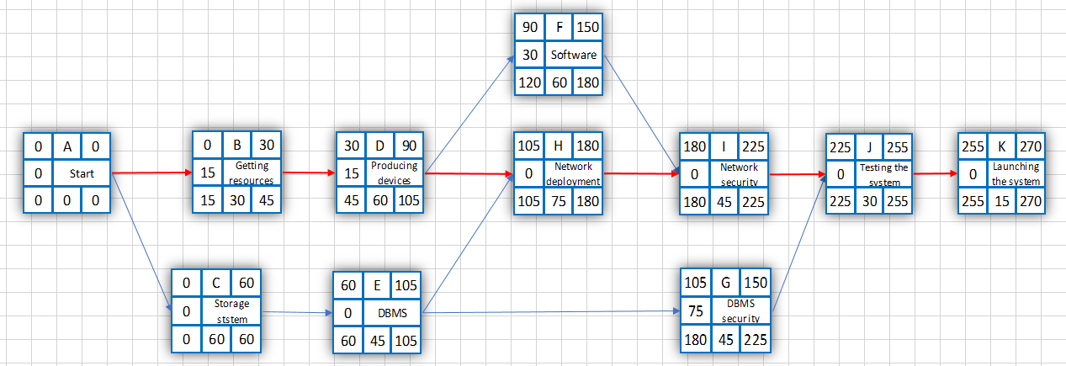
Project network diagram

Slide 11
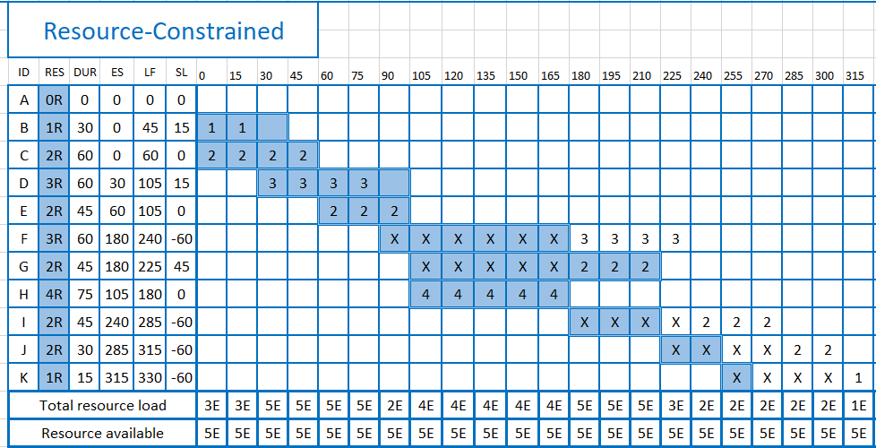
Resource-constrained

Slide 12
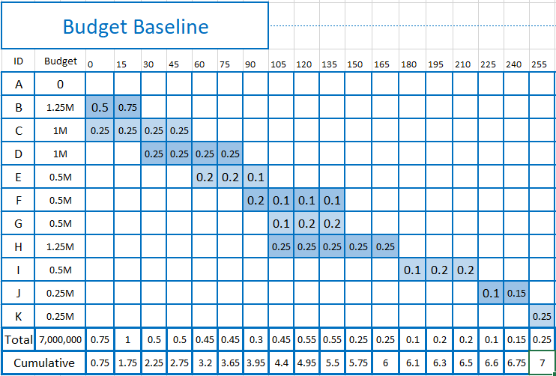

Slide 13
RISK MANAGEMENT & MONITORING
The Risks that the system may face:
(1)Damage in the IS storage systems. (2)Data loss.
(3)Cyber-attack. (4)Damage in the fingerprint scanner devices.
(5)The storage doesn’t have enough space to store the votes and the results.
To deal with it:
(1)Saving spare parts for emergency. (2)Saving a backup copy of the data regularly.
(3)Protecting the system with the latest security methods and best security admins.
(4)Saving spare parts for emergency. (5)Expanding the hardware capacity.
Monitoring the System:
(1)A team of experienced security administrators will take turns to provide high level security against cyber-attacks, especially during the elections period.
(2)The hardware devices will be guarded by the police.
(3)There will be a fire station near the storage systems to protect it from any fire damage.

